Slide 1
Real Time Energy Consumption Analysis
Soham Chakraborty
2276590

Slide 2
Problem Statement
Real-time energy consumption analysis is important because it allows for immediate detection of abnormal energy usage patterns, facilitates timely intervention to prevent energy wastage or system failures, enables optimization of energy resources in real-time, and supports data-driven decision-making for energy management, cost reduction, and sustainability efforts. Additionally, real-time analysis provides insights into energy usage trends, enables predictive maintenance, and enhances overall efficiency and reliability of energy systems.

Slide 3
Technology used
Python (Boto3)
Kinesis Data Stream
Redshift
IAM
Lambda
SNS
DynamoDB

Slide 4
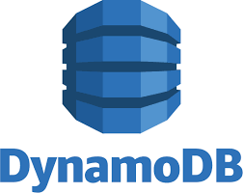

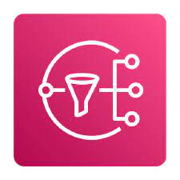
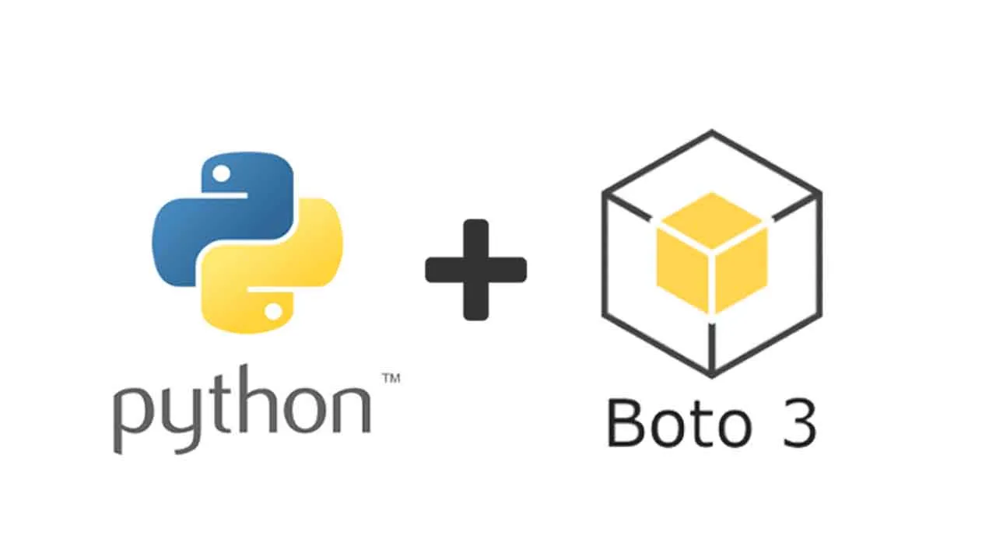
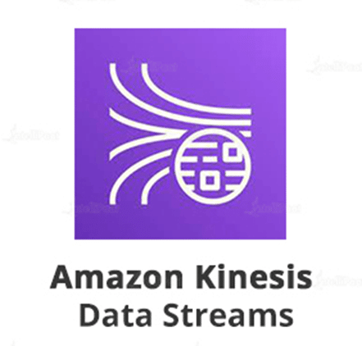
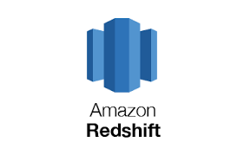
Trigger
Amazon Redshift Streaming Ingestion

Slide 5
Steps
Creating script using boto3 and generating the data
Data Ingestion using Kinesis Data Stream
Sending the real time data from Kinesis Data Stream to Amazon Redshift using Amazon Redshift Streaming Ingestion
Performing data analyzing and visualization using Amazon redshift to gain data driven business insights from the data
Creating a lambda function with the Kinesis data stream as the trigger to generate sns and dynamodb actions
Creating SNS topic and subscription to send custom alerts to subscribed email id
Creating a dynamo db table and Storing threshold-crossing data in DynamoDB which provides a historical record that can be used for compliance reporting and auditing purposes.

Slide 6
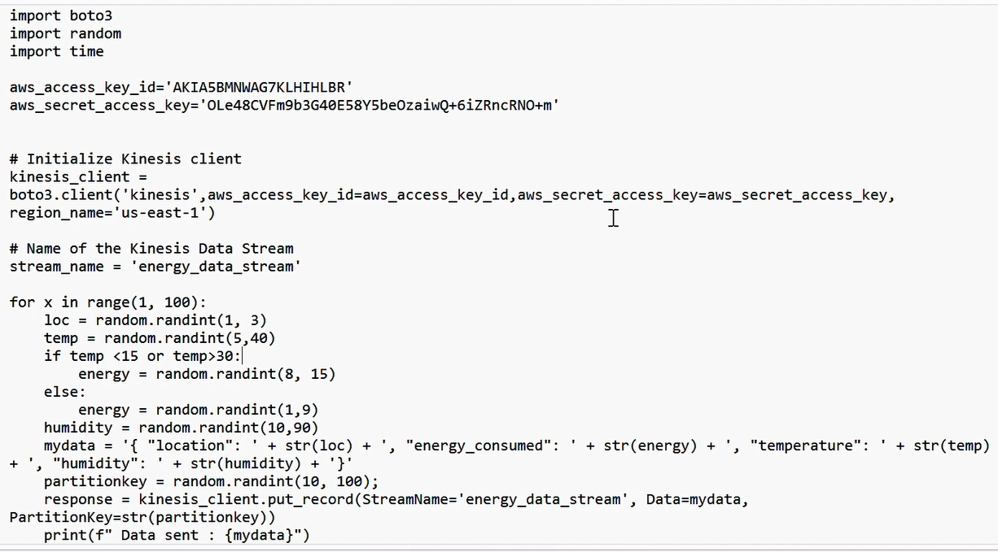
Creating script using boto3 and generating the data

Slide 7
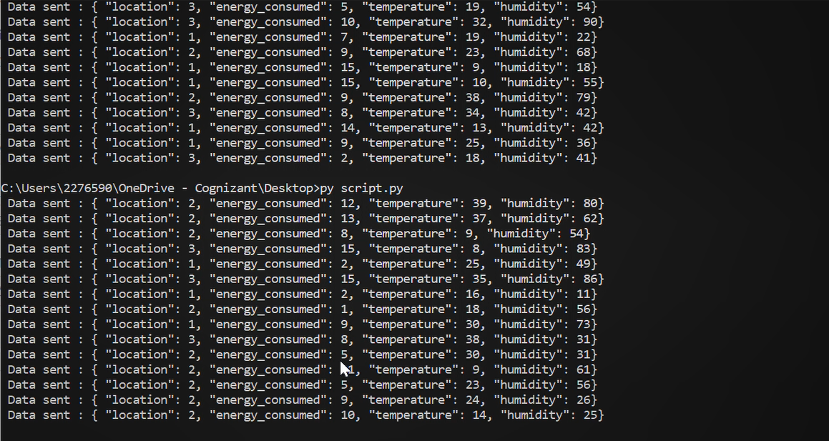
Creating script using boto3 and generating the data

Slide 8
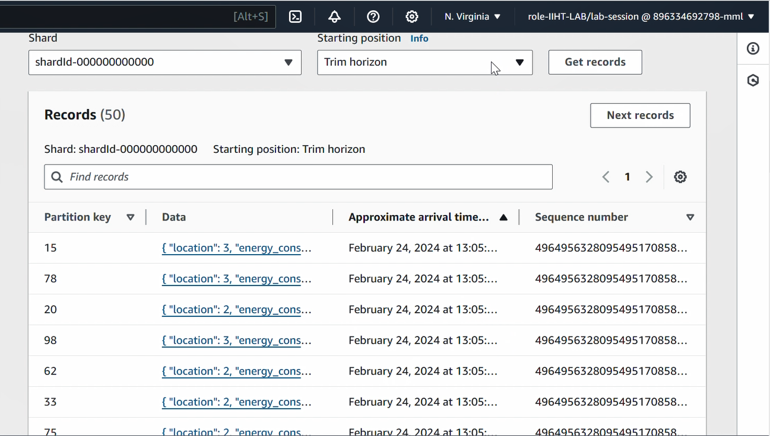
Data Ingestion using Kinesis Data Stream

Slide 9
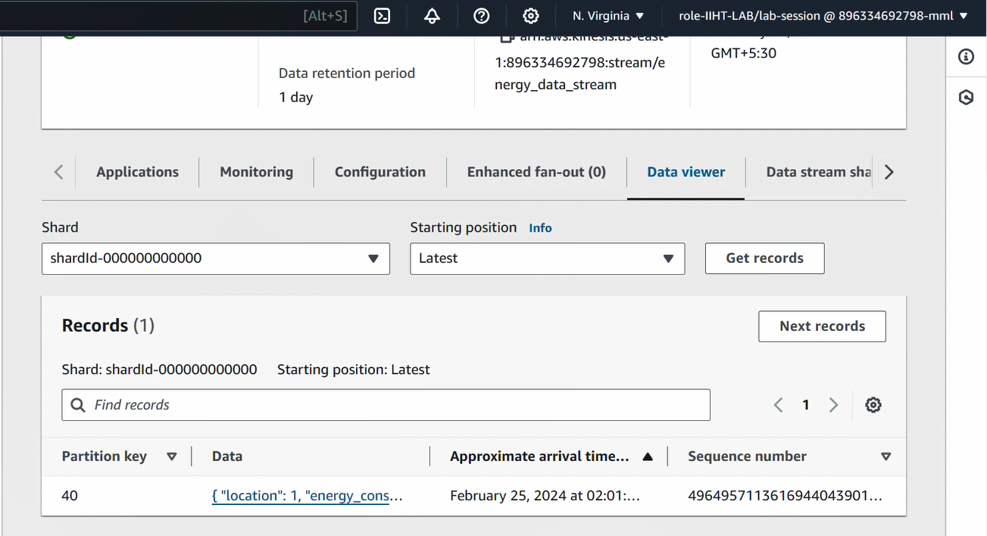
Data Ingestion using Kinesis Data Stream

Slide 10
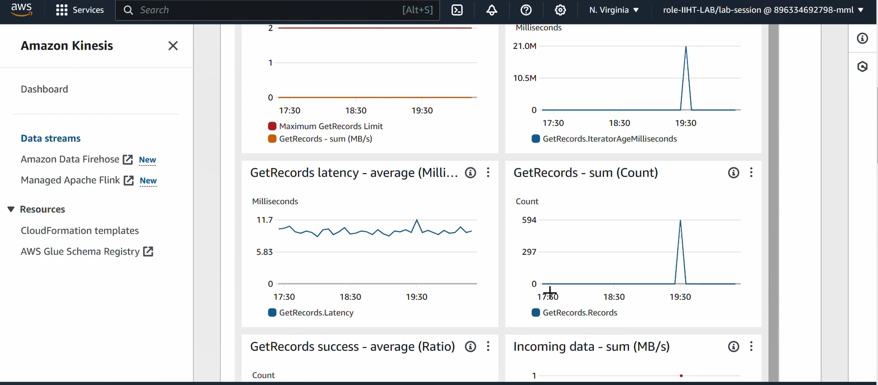
Data Ingestion using Kinesis Data Stream

Slide 11
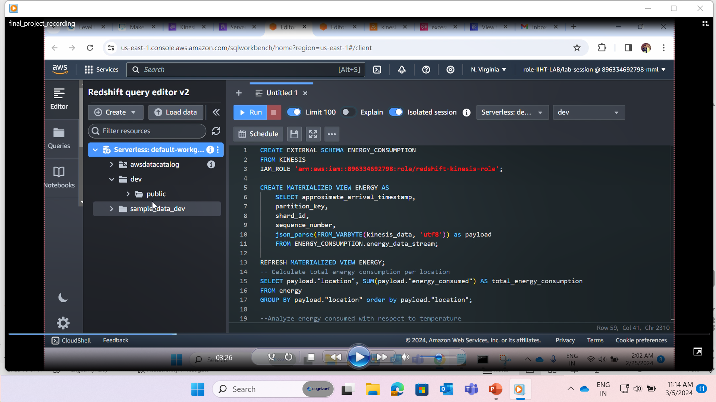
Sending the real time data from Kinesis Data Stream to Amazon Redshift

Slide 12
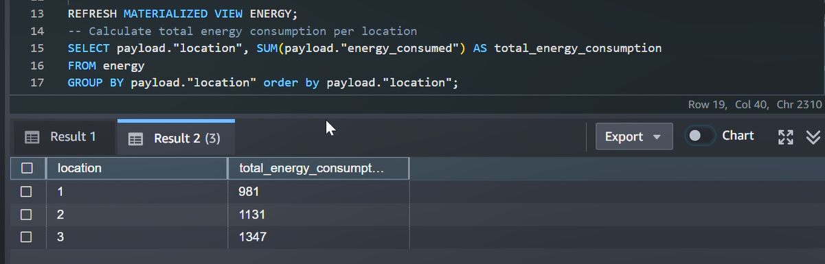
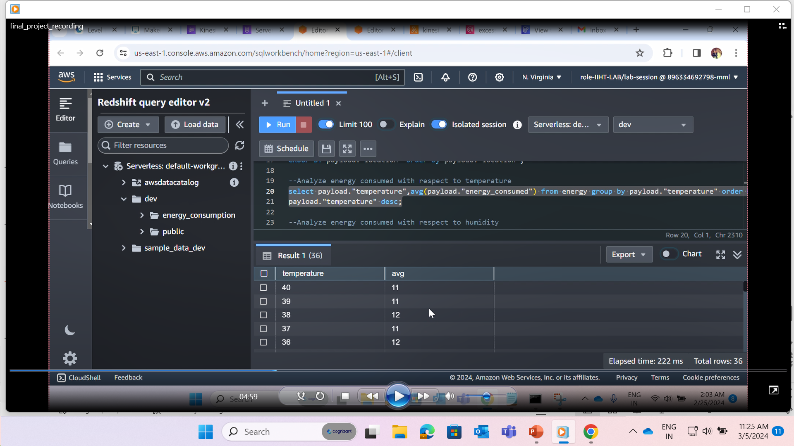
Performing data analyzing and visualization using Amazon redshift to gain data driven business insights from the data

Slide 13
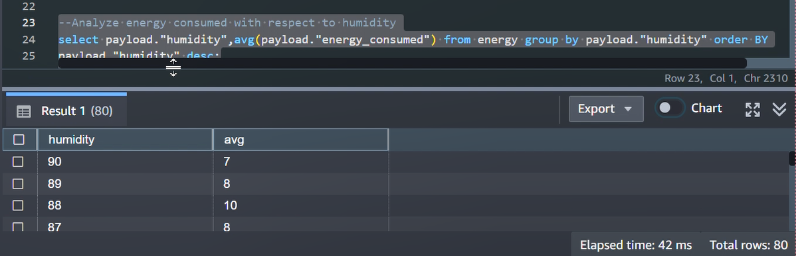
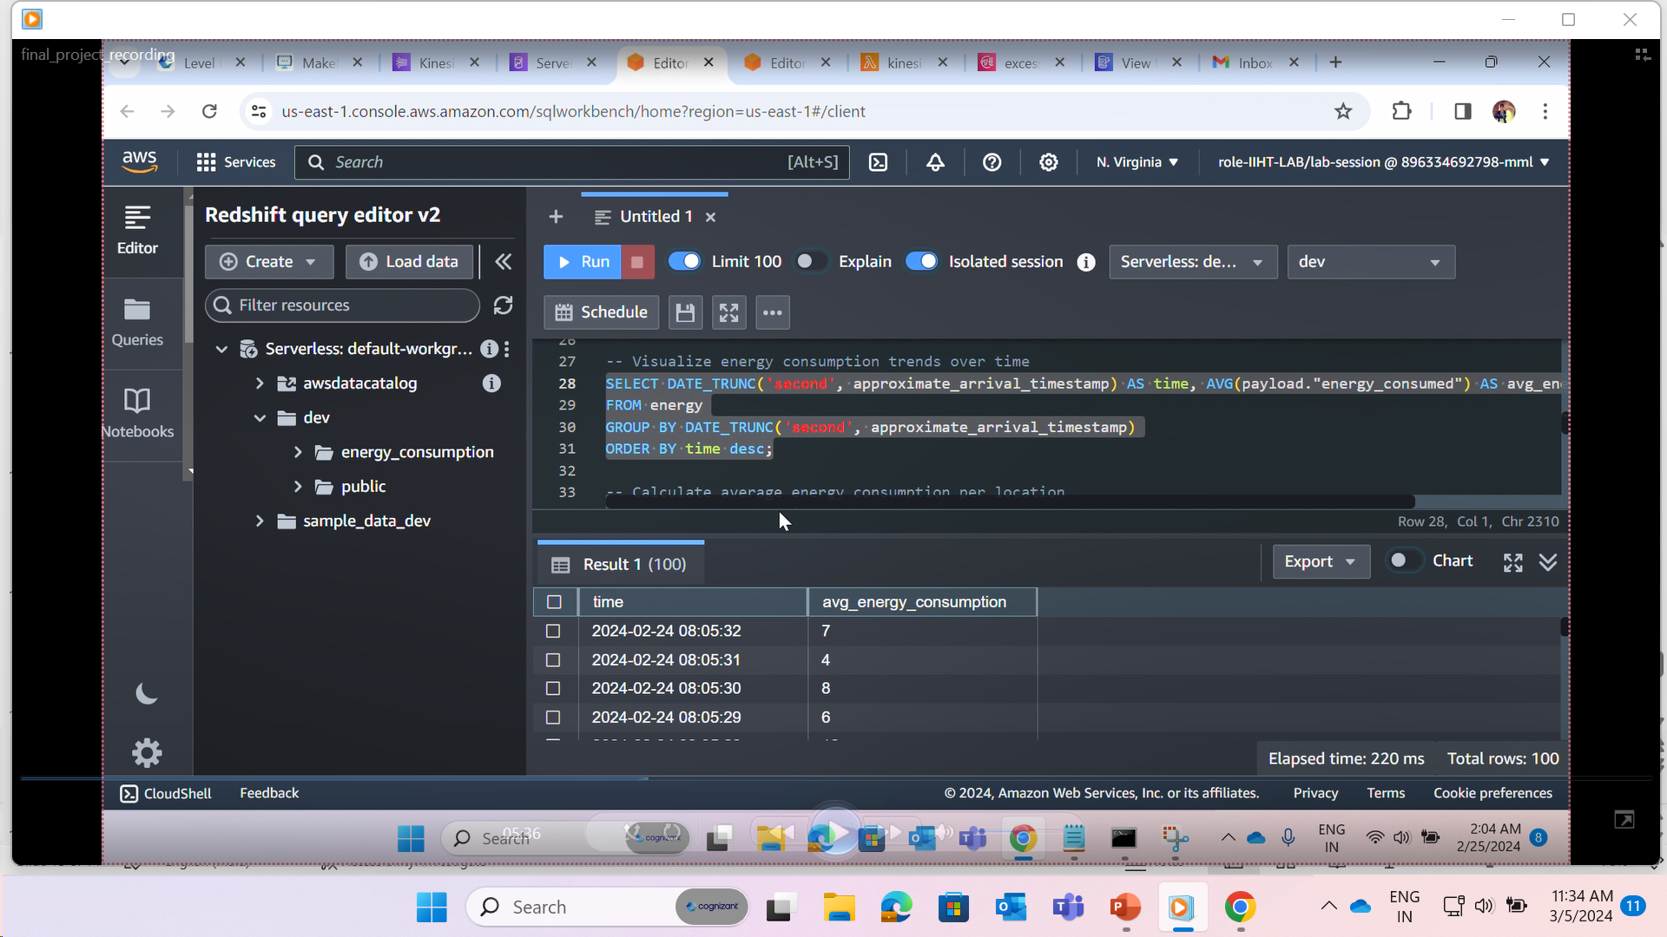
Performing data analyzing and visualization using Amazon redshift to gain data driven business insights from the data

Slide 14
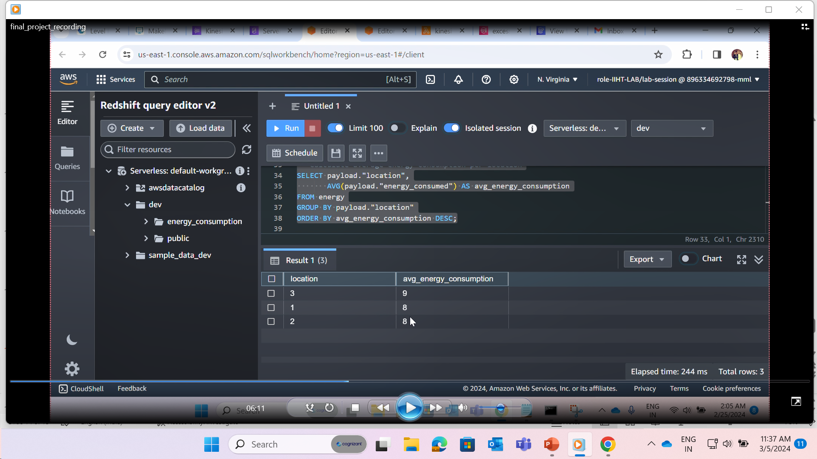
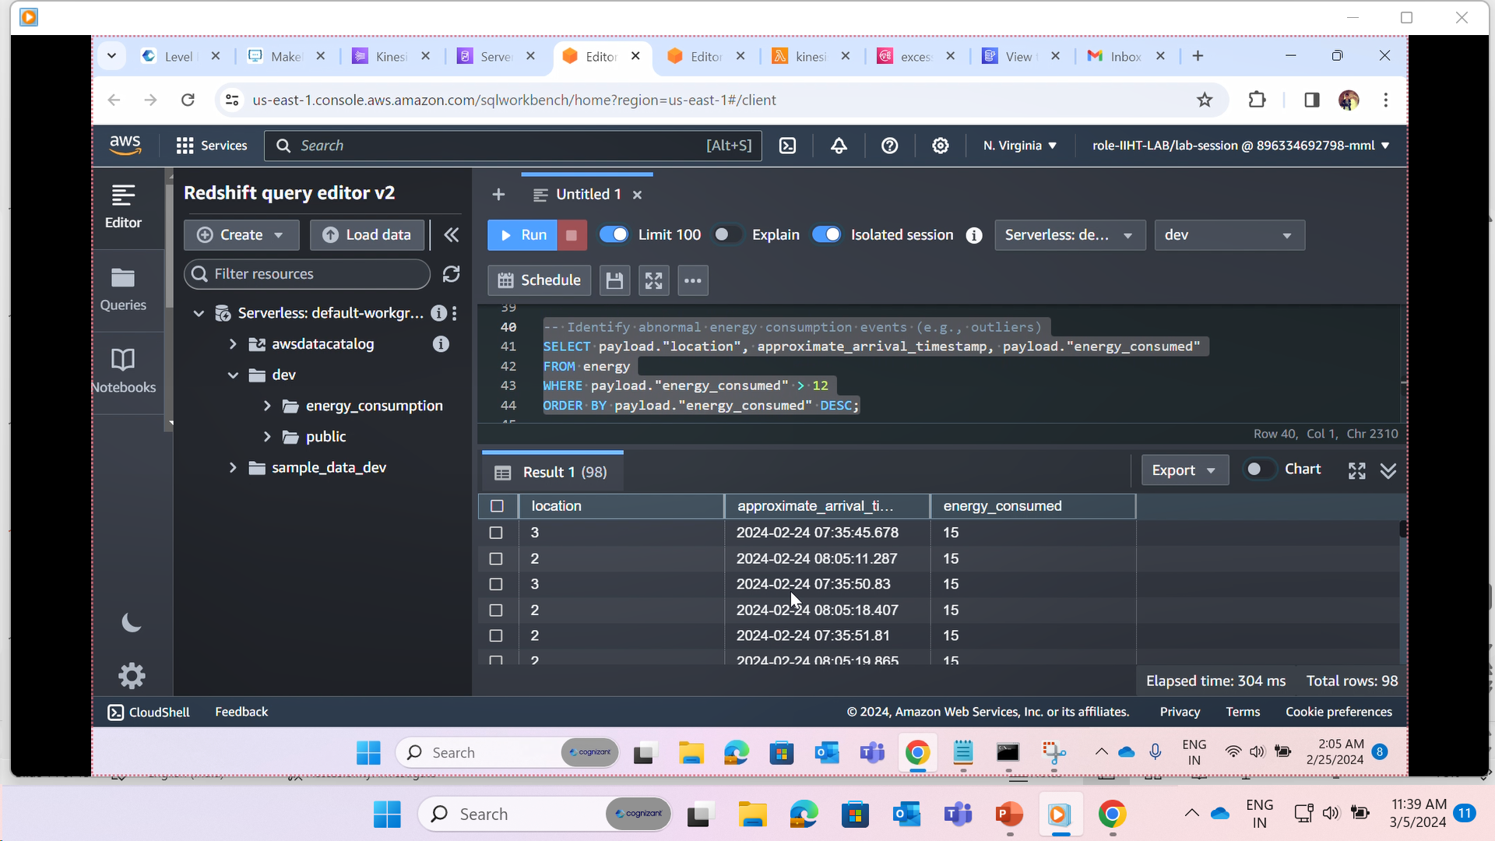
Performing data analyzing and visualization using Amazon redshift to gain data driven business insights from the data

Slide 15
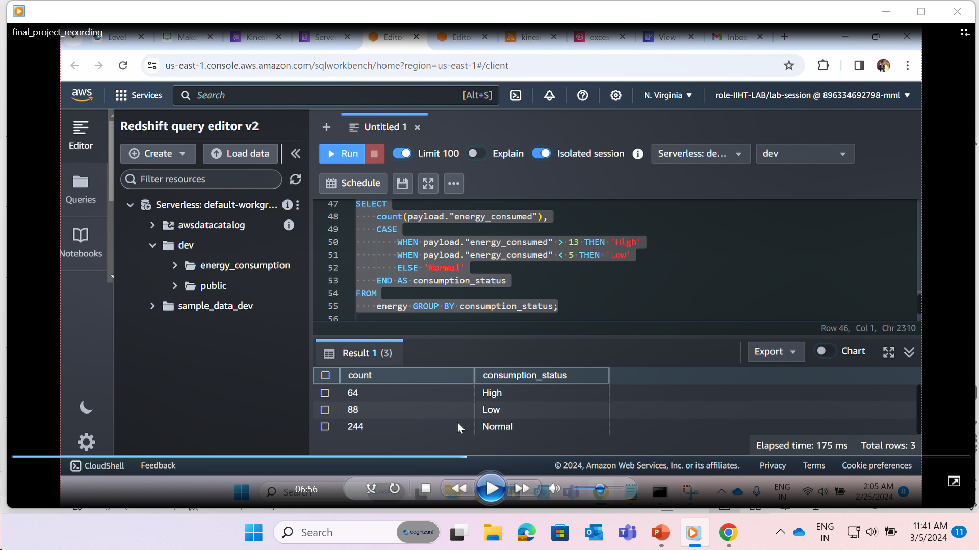
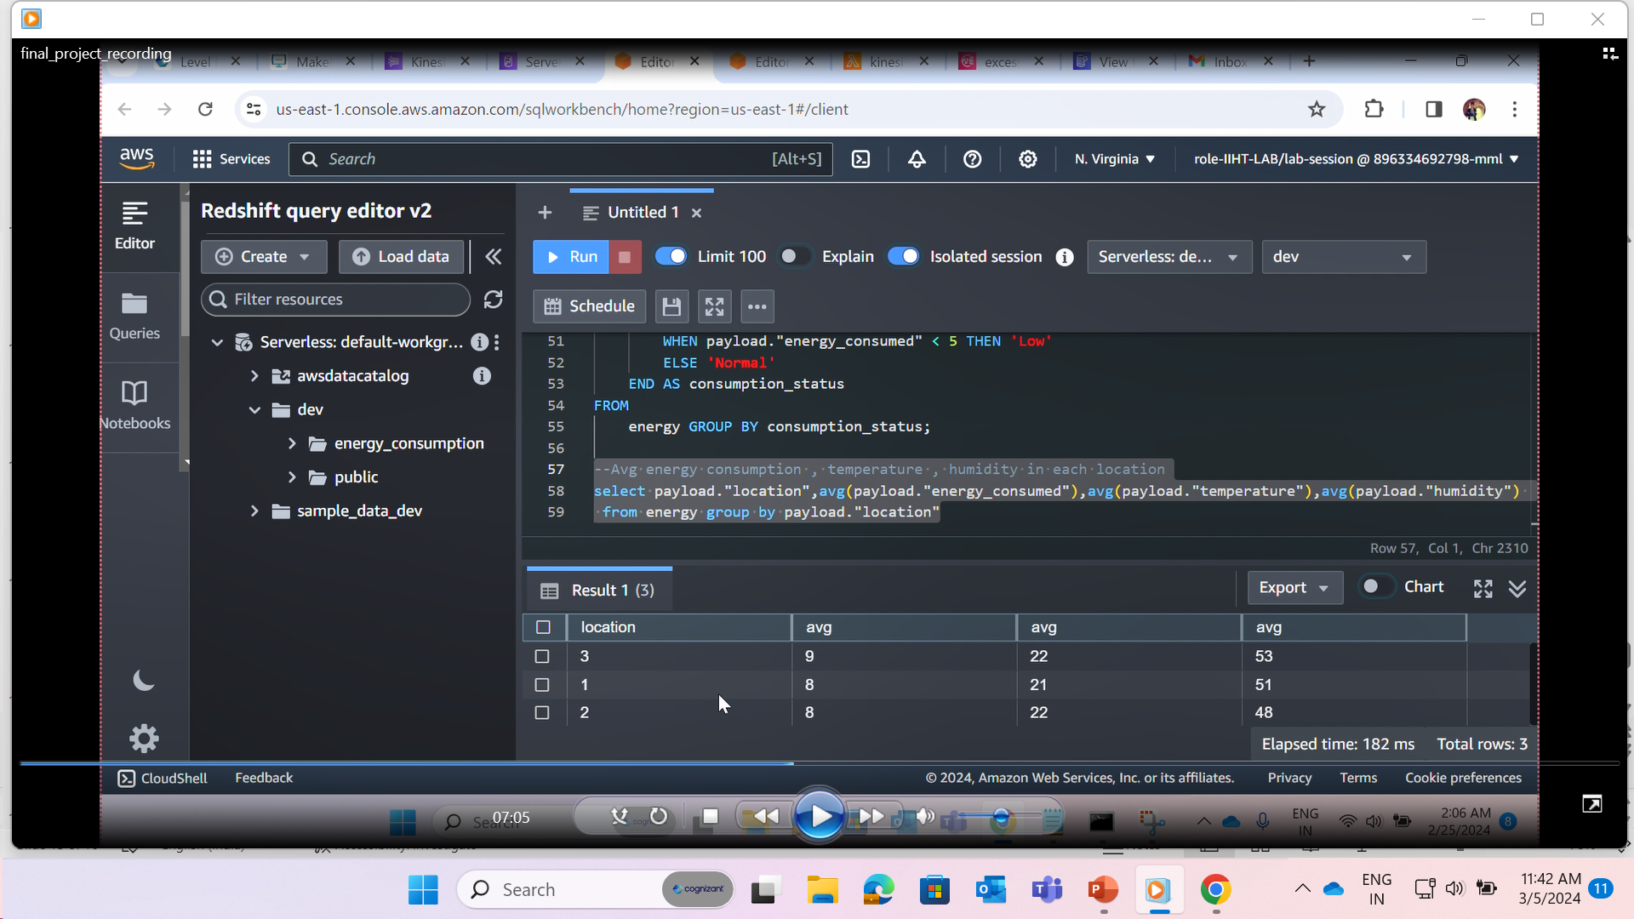
Performing data analyzing and visualization using Amazon redshift to gain data driven business insights from the data

Slide 16
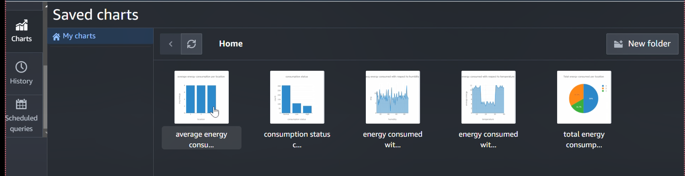
Performing data analyzing and visualization using Amazon redshift to gain data driven business insights from the data

Slide 17
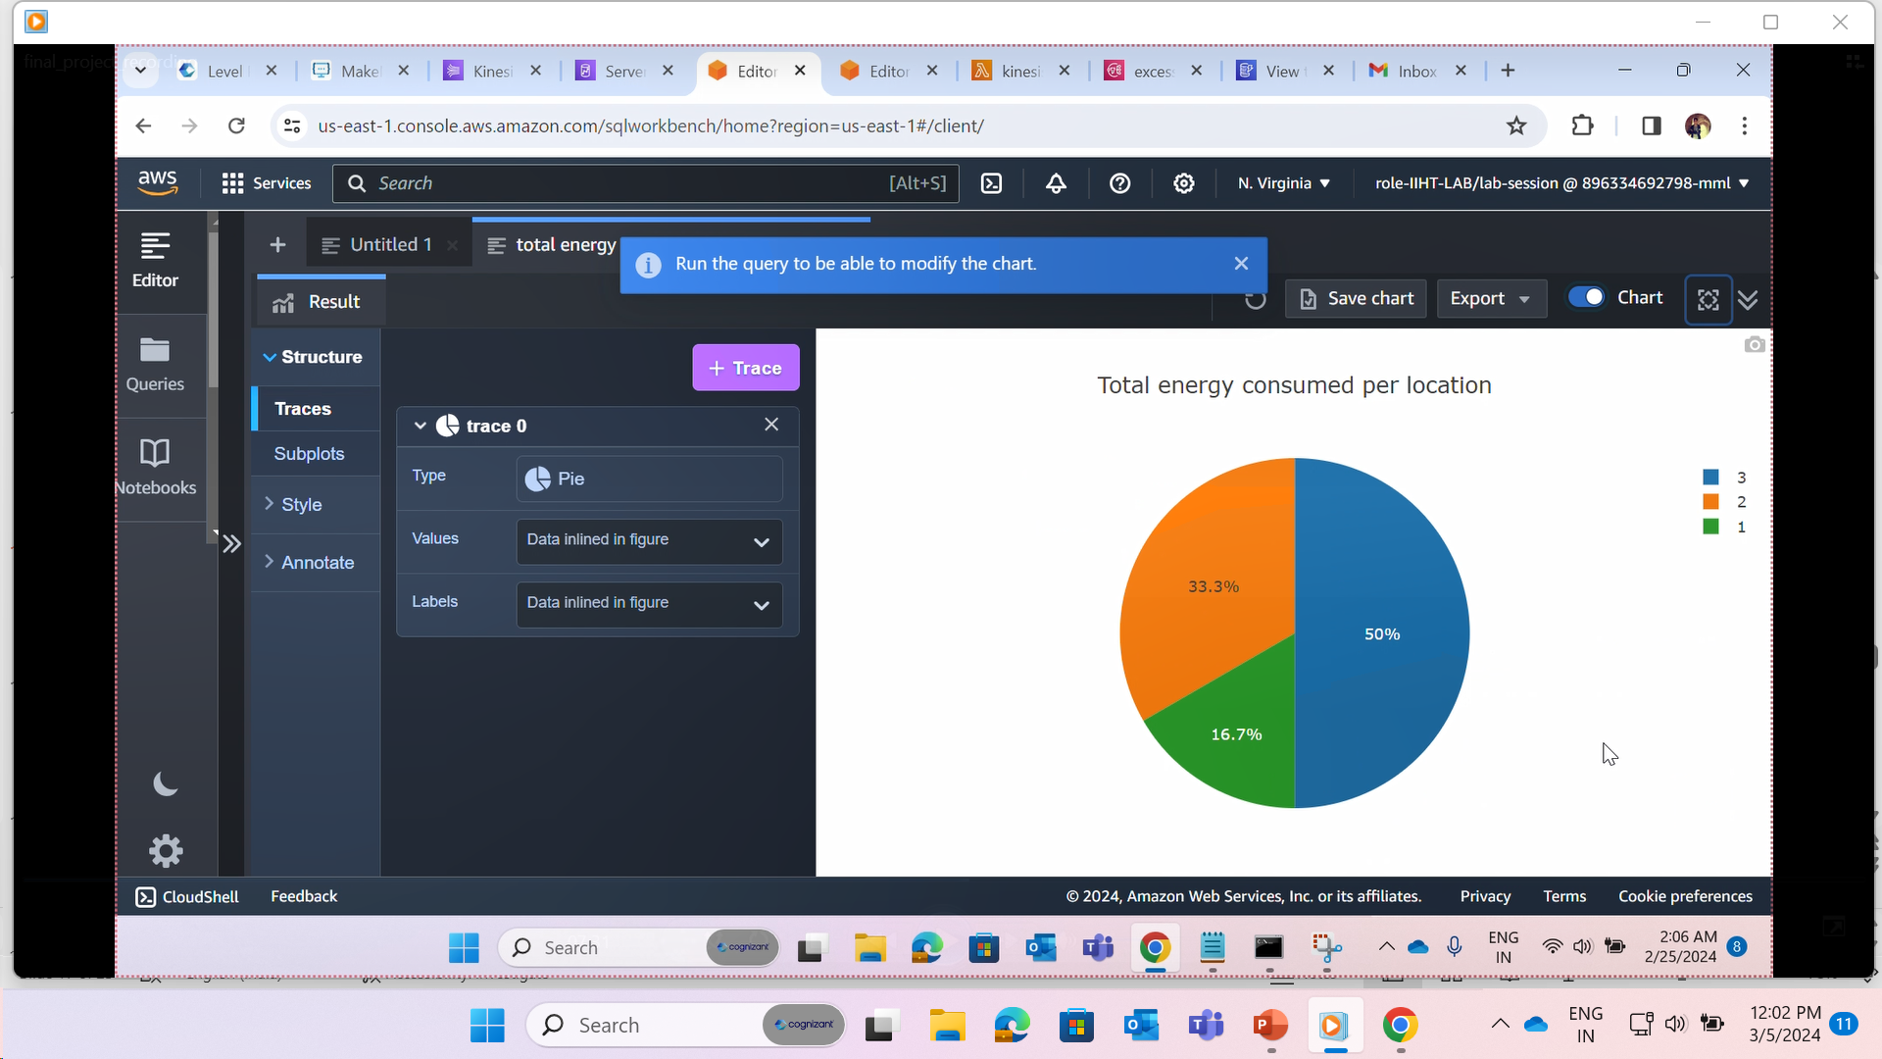
Performing data analyzing and visualization using Amazon redshift to gain data driven business insights from the data

Slide 18
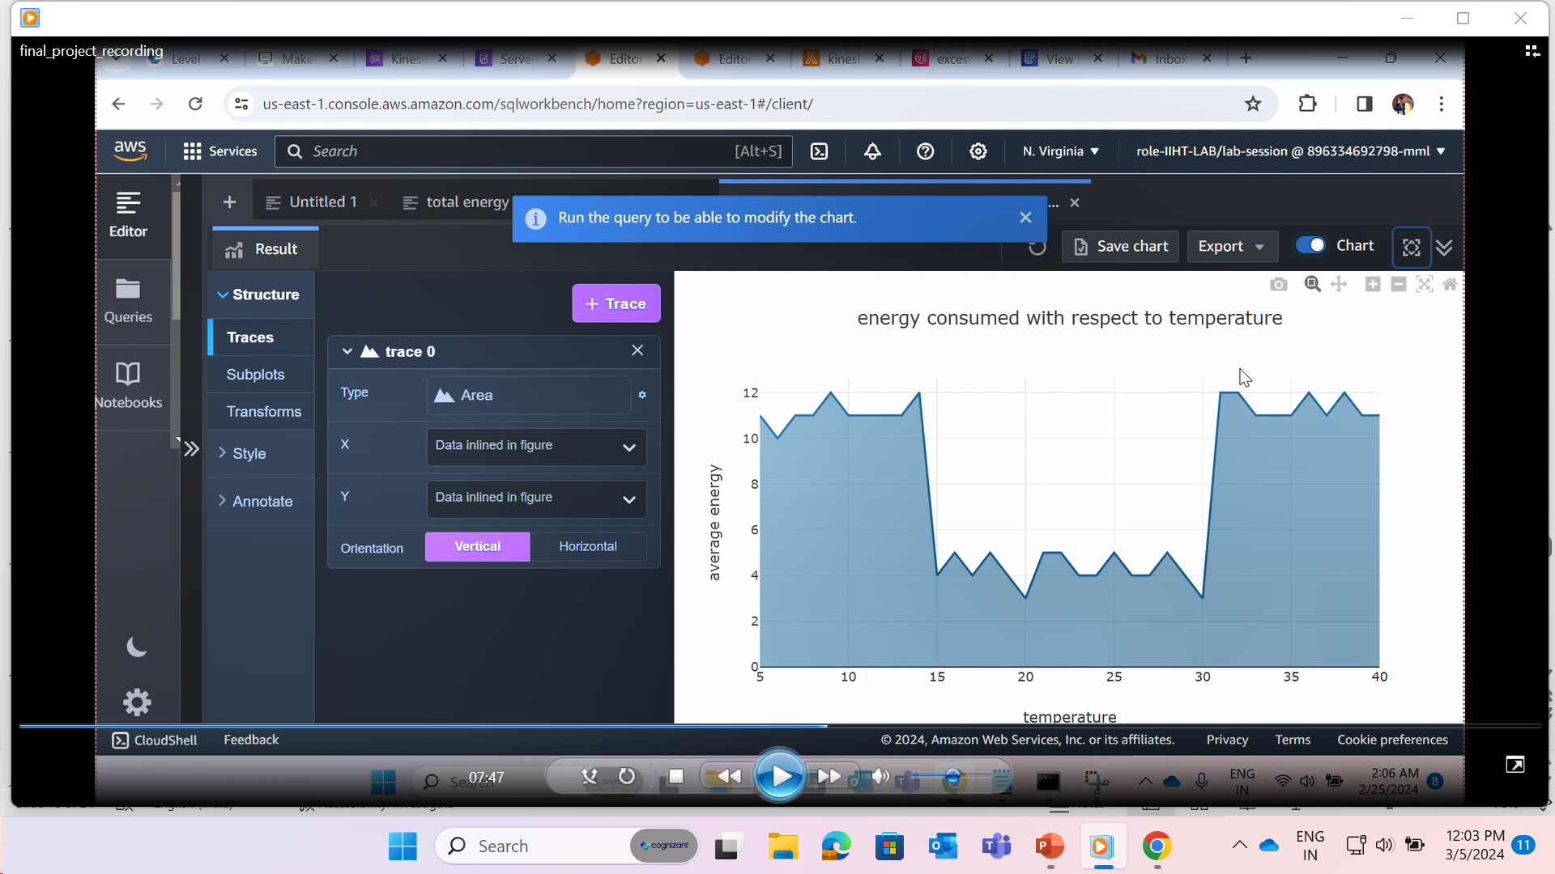
Performing data analyzing and visualization using Amazon redshift to gain data driven business insights from the data

Slide 19
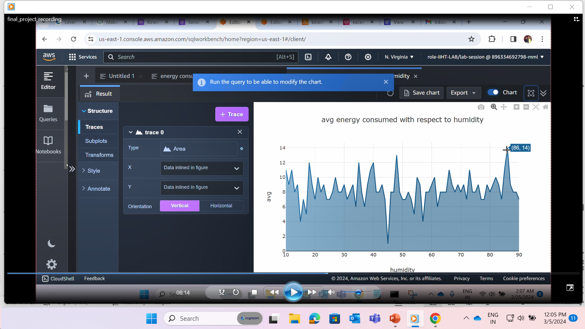
Performing data analyzing and visualization using Amazon redshift to gain data driven business insights from the data

Slide 20
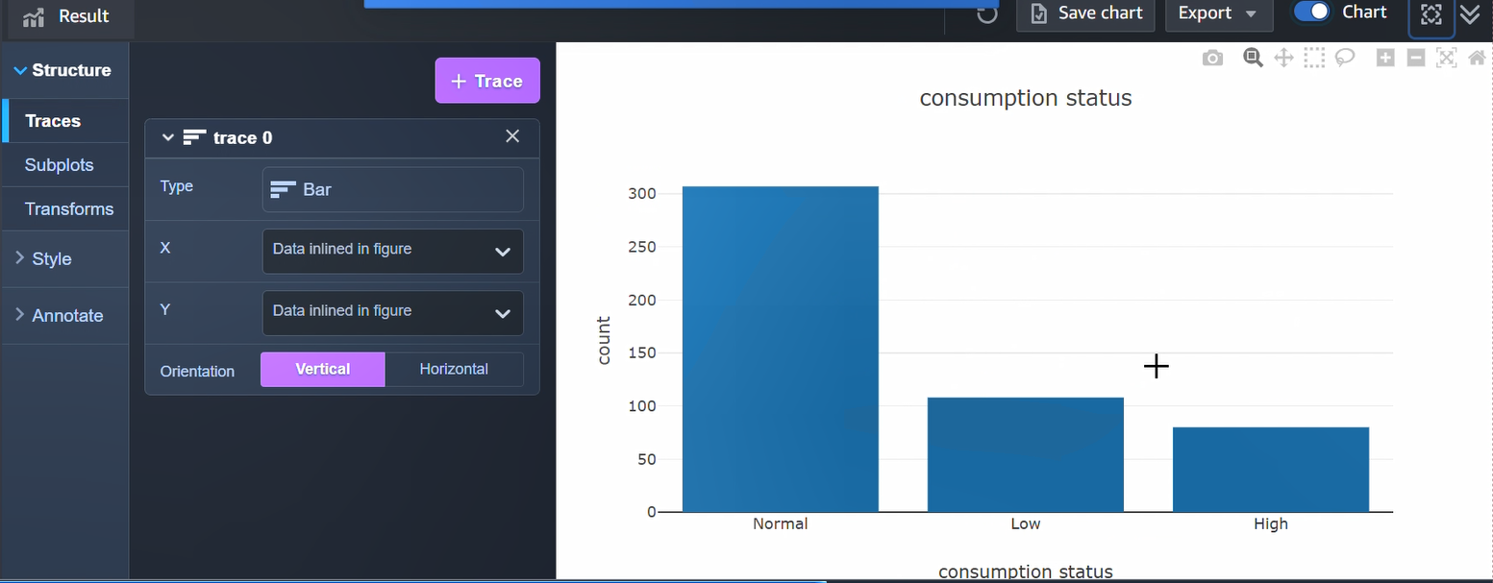
Performing data analyzing and visualization using Amazon redshift to gain data driven business insights from the data

Slide 21
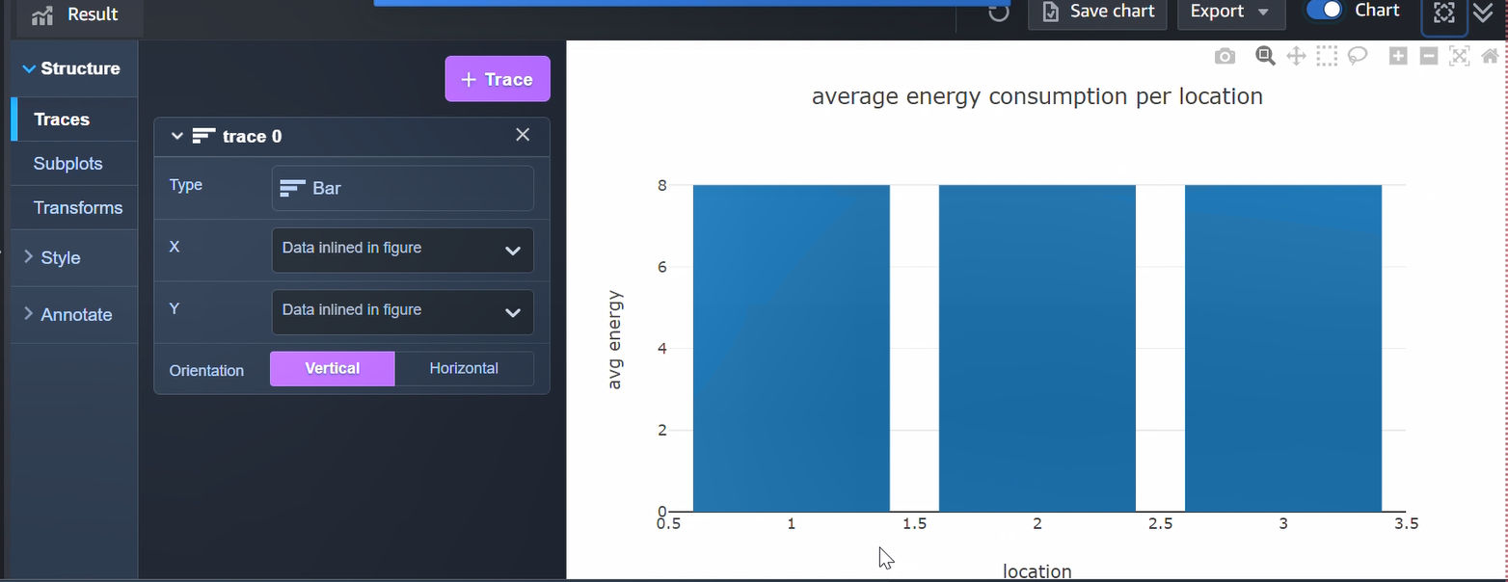
Performing data analyzing and visualization using Amazon redshift to gain data driven business insights from the data

Slide 22
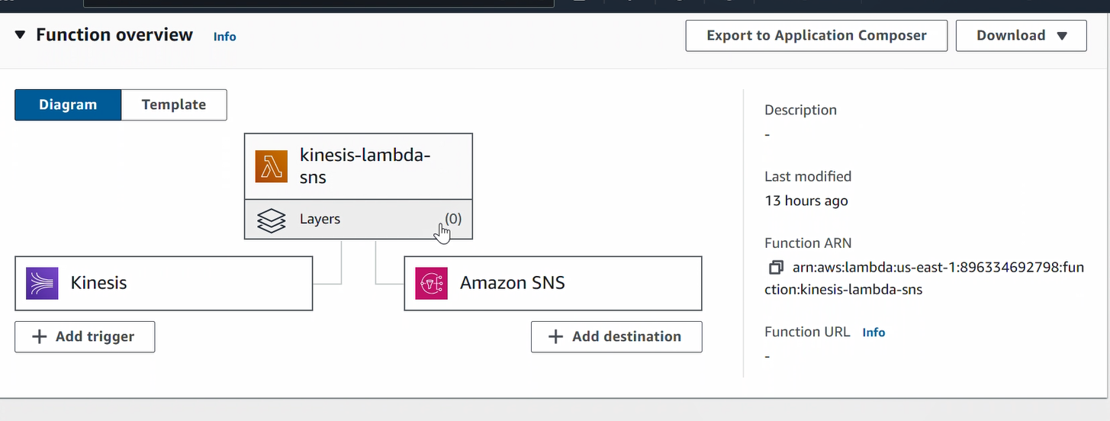
Creating a lambda function with the Kinesis data stream as the trigger to generate SNS and DynamoDB actions

Slide 23
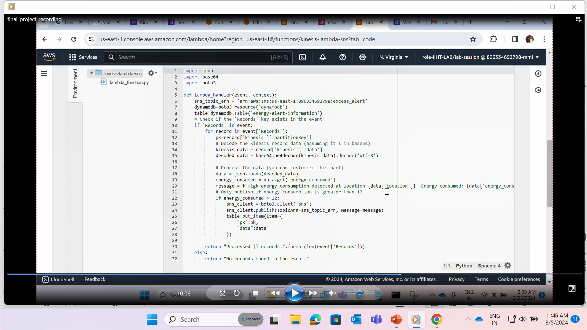
Creating a lambda function with the Kinesis data stream as the trigger to generate SNS and DynamoDB actions

Slide 24
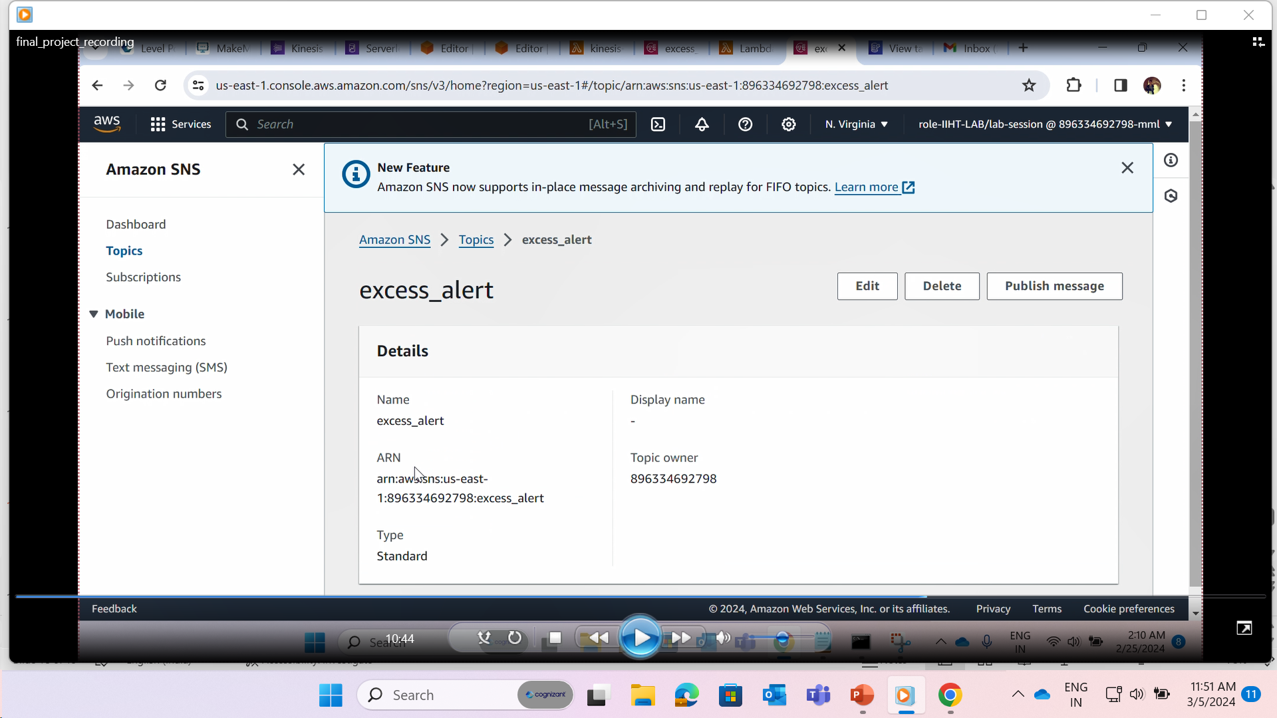
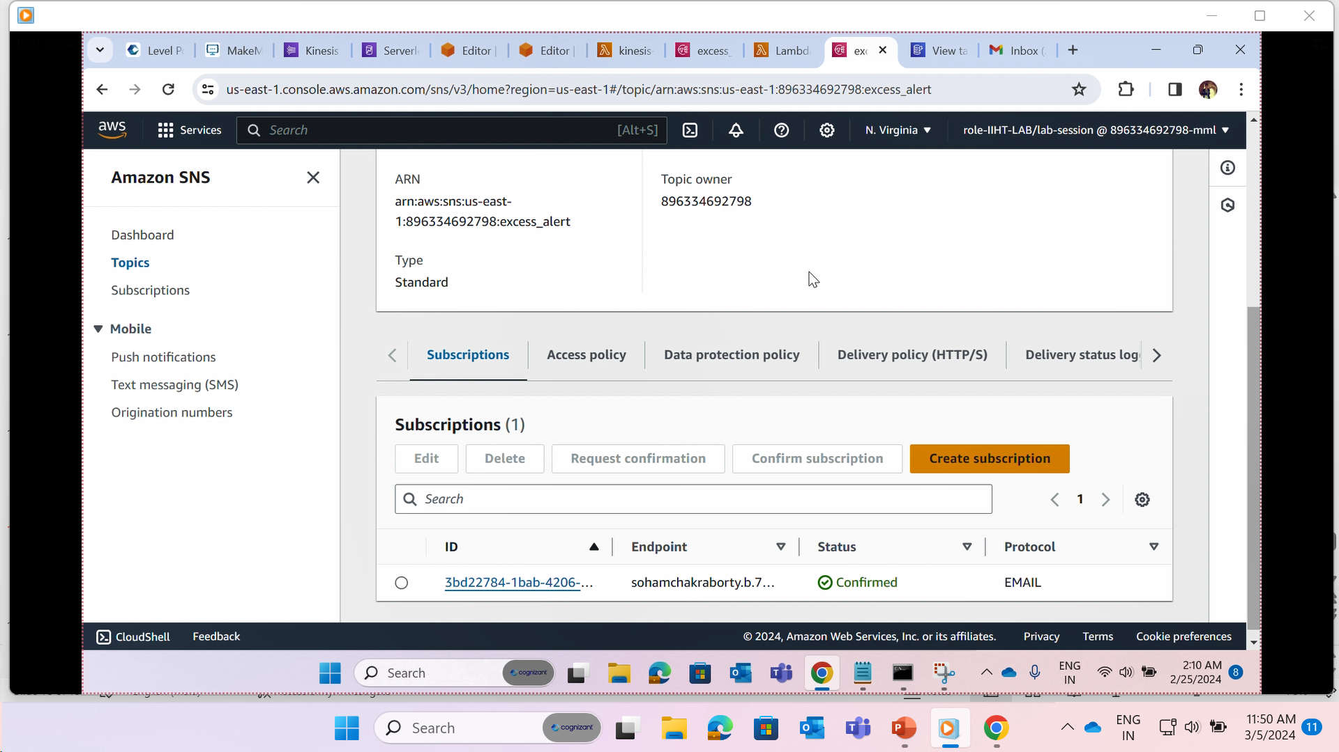
Creating SNS topic and subscription to send custom alerts to subscribed email id

Slide 25
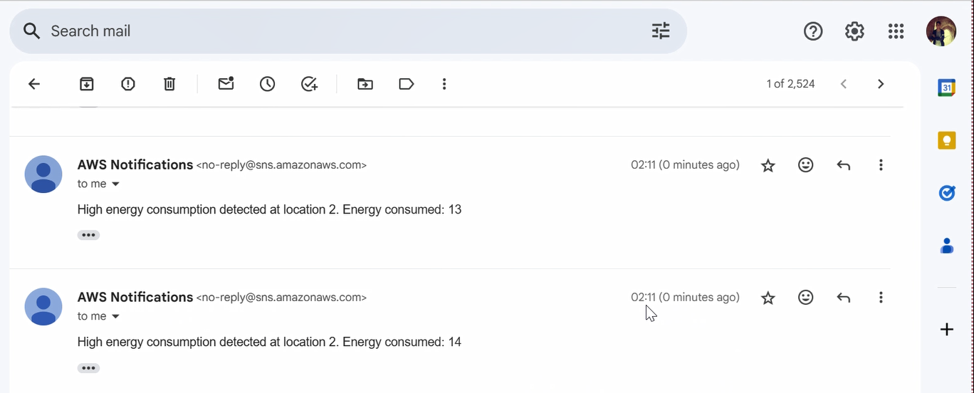
Creating SNS topic and subscription to send custom alerts to subscribed email id

Slide 26
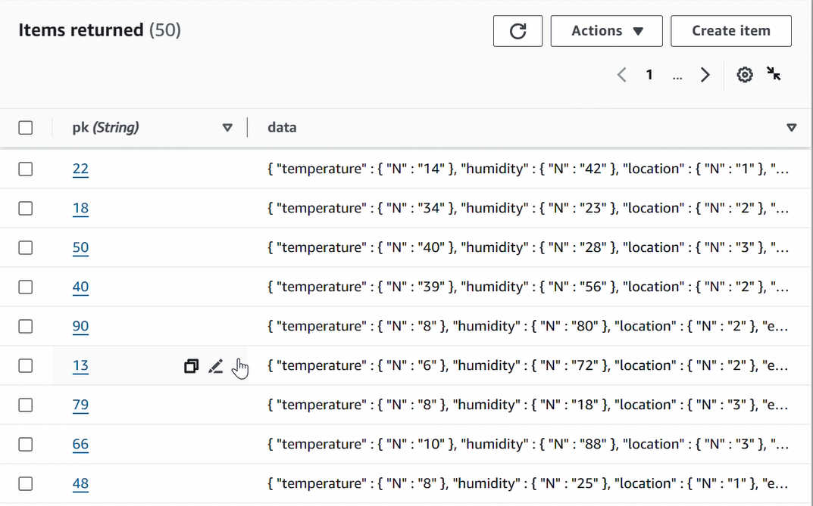
Creating a dynamo db table and Storing threshold-crossing data in DynamoDB which provides a historical record that can be used for compliance reporting and auditing purposes.

